Slide 1
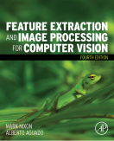
Lecture 3 Image Sampling
COMP3204 Computer Vision
How is an image sampled and what does it imply?
 | Book pp 44-66

Slide 2
Content
What can go wrong with sampling?
How does the discrete Fourier transform work, and help?

Slide 3

Sampling Signals
original continuous signal
good bad
sampling sampling
(aliased)

Slide 4
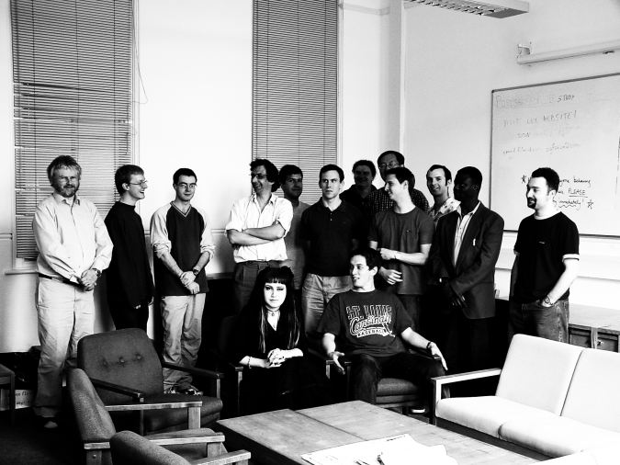
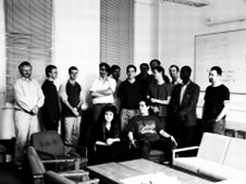
Aliasing in Sampled Imagery
(a) high resolution | (c) low resolution – aliased

Slide 5
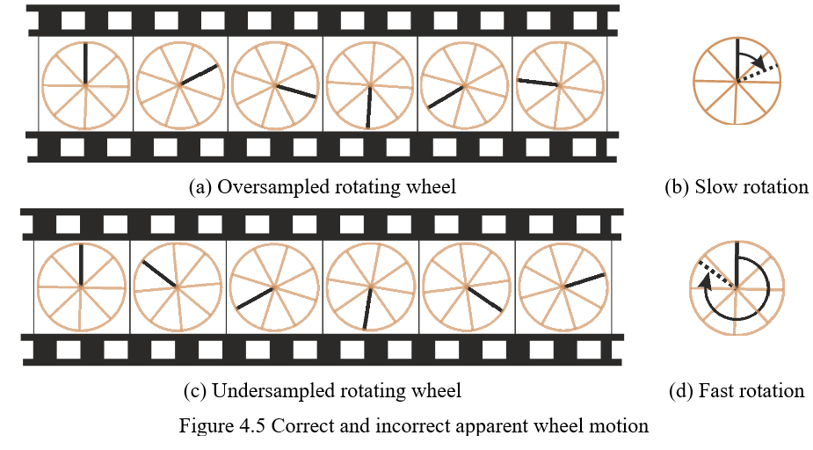
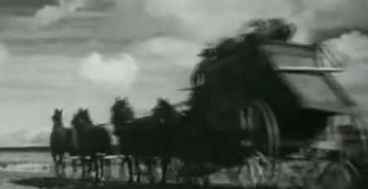
Correct and Incorrect Apparent Wheel Motion
https://www.youtube.com/watch?v=e1EqXE06xr8

Slide 6
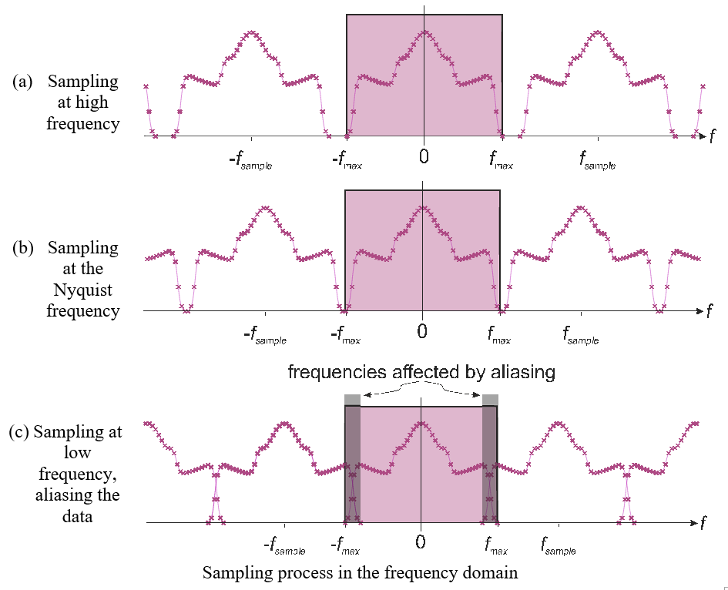

In the frequency domain
Spectra repeat
If sampling is just right, spectra just touch
Minimum sampling frequency = 2 × max

Slide 7
Sampling theory
Nyquist’s sampling theorem
In order to be able to be able to reconstruct a signal from its samples we must sample at minimum at twice the maximum frequency in the original signal
E.g. speech 6kHz, sample at 12 kHz
Video bandwidth (CCIR) is 5MHz
Sampling at 10MHz gave 576×576 images
Guideline: “two pixels for every pixel of interest”

Slide 8
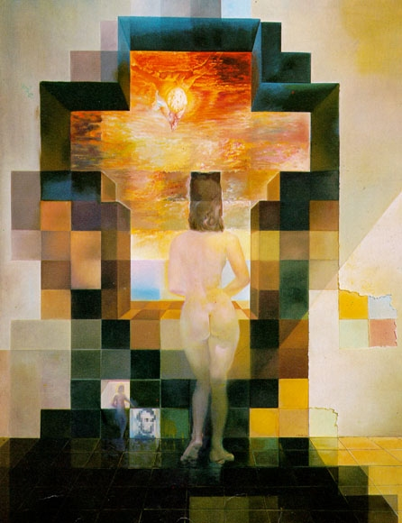
https://www.pinterest.com/pin/275423333431517864/

Slide 9
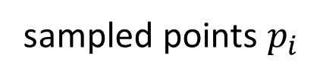
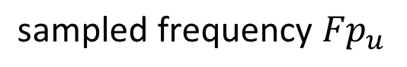
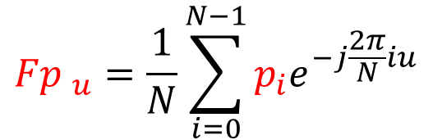
1D Discrete Fourier transfrom
$\text{Discrete} \text{Fourier} \text{calculates} \text{frequency}$ from data points
$${Fp }_{u}=\frac{1}{N}\sum_{i=0}^{N−1}{p_{i}e^{−j\frac{2π}{N}iu}}$$
$$\text{sampled} \text{frequency} {Fp}_{u}$$
sampled points $p_{i}$

Slide 10
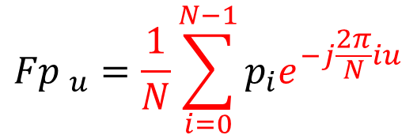
1D Discrete Fourier transfrom
$\text{Discrete} \text{Fourier} \text{calculates} \text{frequency}$ from data points
$${Fp }_{u}=\frac{1}{N}\sum_{i=0}^{N−1}{p_{i}e^{−j\frac{2π}{N}iu}}$$
$$\text{sampled} \text{frequency} {Fp}_{u}$$
sampled points $p_{i}$
N points

Slide 11
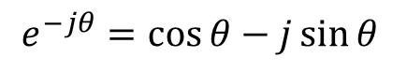
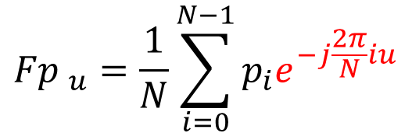
1D Discrete Fourier transfrom
$\text{Discrete} \text{Fourier} \text{calculates} \text{frequency}$ from data points
$${Fp }_{u}=\frac{1}{N}\sum_{i=0}^{N−1}{p_{i}e^{−j\frac{2π}{N}iu}}$$
$$\text{sampled} \text{frequency} {Fp}_{u}$$
sampled points $p_{i}$
N points
$$e^{−jθ}=\cos{θ}−j\sin{θ}$$

Slide 12
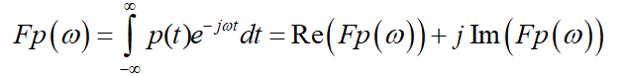
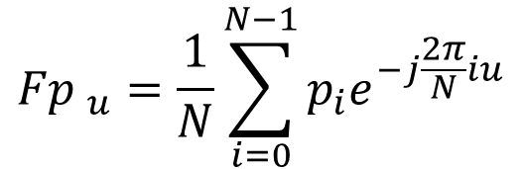
1D Discrete Fourier transfrom
$\text{Discrete} \text{Fourier} \text{calculates} \text{frequency}$ from data points
$${Fp }_{u}=\frac{1}{N}\sum_{i=0}^{N−1}{p_{i}e^{−j\frac{2π}{N}iu}}$$
Comparison
$$\text{sampled} \text{frequency} {Fp}_{u}$$
sampled points $p_{i}$
N points
$$e^{−jθ}=\cos{θ}−j\sin{θ}$$

Slide 13
Fireside time
Why/ how did you (I) get into biometrics?

Slide 14
Transform Pair for Sampled Pulse
Discrete Fourier transform
(a) sampled pulse | (b) DFT of sampled pulse
Inverse Discrete Fourier transform

Slide 15
(a) original sampled signal | (b) first coefficient Fp₀
(c) second coefficient Fp₁ | (d) adding Fp₁ and Fp₀
(e) adding Fp₀, Fp₁ , Fp₂ and Fp₃ | (f) adding all six frequency components
signal reconstruction from its transform components

Slide 16
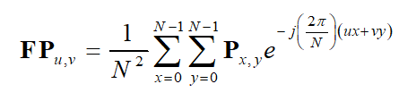
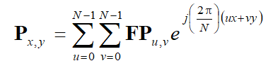
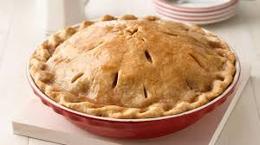
2D Fourier transform
Forward transform
where two dimensions of space, x and y
two dimensions of frequency, u and v
image NxN pixels P_{x,y}
Inverse transform
π??

Slide 17
Reconstruction

Slide 18
Implementation is via (Fast) FFT
while L<cols %iterate until log2(cols)-1 levels have been performed
for j=1:2*L:cols %do all the points in L/2 batches
for i=1:L %now do L butterflies
upp(((j+1)/2)+i-1)= Fp(j+i-1)+Fp(j+L+i-1)*exp(-1j*2*pi*(i-1)/(L*2));
low(((j+1)/2)+i-1)= Fp(j+i-1)-Fp(j+L+i-1)*exp(-1j*2*pi*(i-1)/(L*2));
end
end
for j=1:2*L:cols %copy the components across, to the right places
for i=1:L
Fp(j+i-1)=upp(((j+1)/2)+i-1);
Fp(j+L+i-1)=low(((j+1)/2)+i-1);
end
end
L=L*2; %and go and do the next level (up)
end
(this is a 1-D FFT)

Slide 19
Shift invariance

Slide 20
Rotation

Slide 21
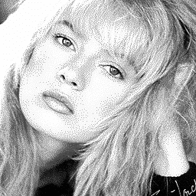
Filtering
Fourier gives access to frequency components

Slide 22
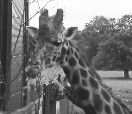
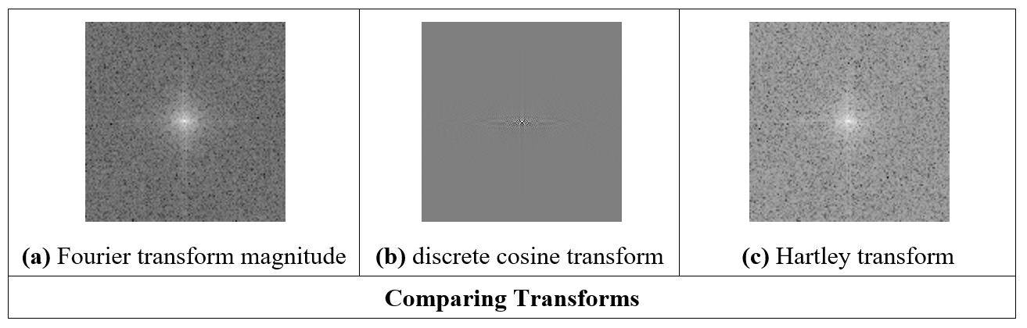
Other transforms

Slide 23
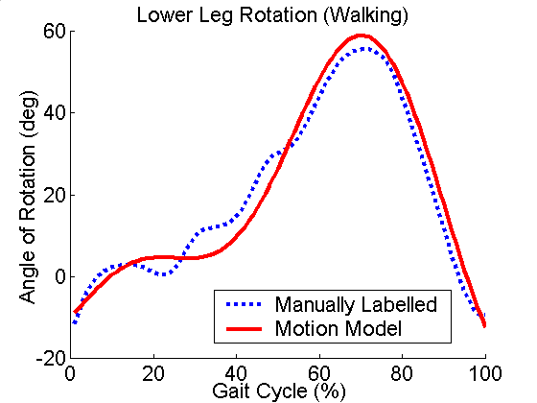
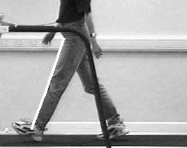
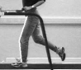
Modelling Gait(s)
Extended pendular thigh-model, based on angles
Uses forced oscillator/ bilateral symmetry/ phase coupling
h
l_{T}
θ_{T}
m_{T}
l_{K}
θ_{K}
m_{K}
23
Yam, Nixon and Carter, AVBPA 2001, Patt. Recog. 2004

Slide 24
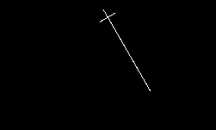
Modeling the Thigh’s Motion 1
24

Slide 25
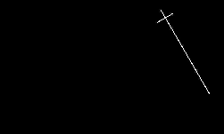
Modeling the Thigh’s Motion 2
25

Slide 26
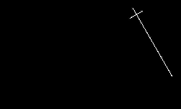
Modeling the Thigh’s Motion 3
26

Slide 27

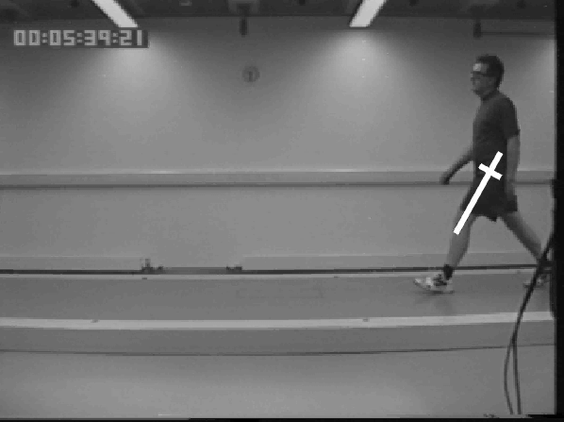
Validity?
27

Slide 28
Applications of 2D FT
Understanding and analysis
Speeding up algorithms
Representation (invariance)
Coding
Recognition/ understanding (e.g. texture)

Slide 29

Takeaway time
1 – need to sample at a high enough frequency
2 – aliasing corrupts image information
3 – discrete Fourier allows analysis and understanding
4 – Fourier has many properties and advantages
…. but it’s complex. So we’ll move on to processing images
Notes:
Kohinoor Kerala

